Slide 1

SHOPNEST STORE DATA ANALYTICS (POWER BI Capstone Project-SKILLOVILLA) -ABHIJEE RANJAN

Slide 2
CONTENTS :
Top Categories by Total Price
Delayed Orders Analysis
Monthly Comparison of Delayed and On-Time Orders
Payment Method Analysis
Product Rating Analysis
State-wise Sales Analysis
Seasonal Sales Patterns
Revenue Analysis

Slide 3
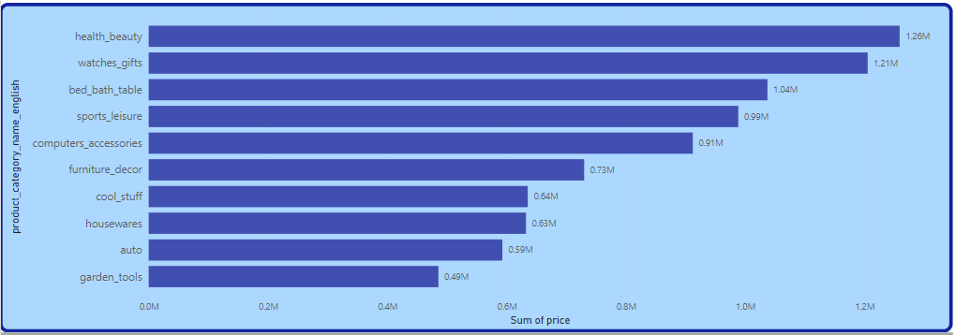
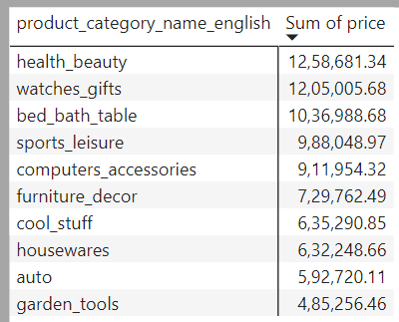
Top Categories by Total Price: Identify and visually represent the top 10 product categories by total sales.
At 12,58,681.34, Health beauty product had the highest Sum of price and was 159.38% higher than garden tools, which had the lowest Sum of price at 4,85,256.46.﻿
Health beauty accounted for 14.85% of Sum of price.
Across all 10 product, Sum of price ranged from 4,85,256.46 to 12,58,681.34.﻿ ﻿

Slide 4
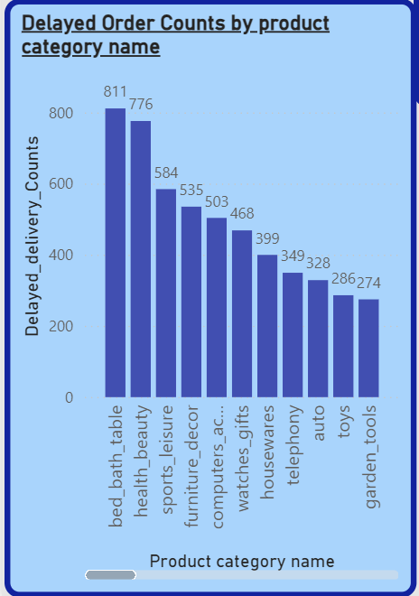
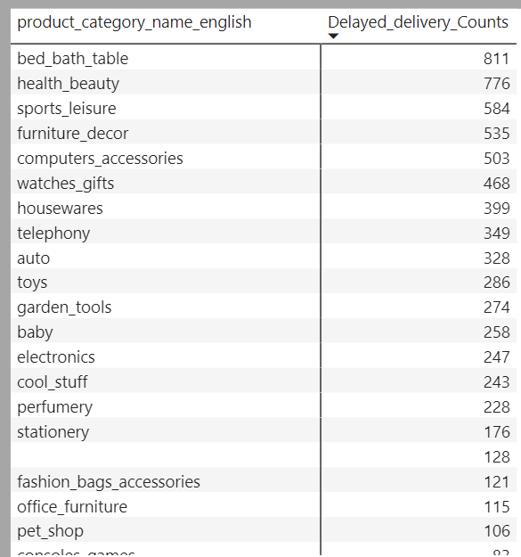
Delayed Orders Analysis: Determine the number of delayed orders in each category. Note : An order is considered delayed if the actual delivery date is later than the estimated delivery date.
﻿﻿Delayed delivery Counts was highest for bed bath table at 811, followed by health beauty and sports leisure and the list goes on.
Bed bath table accounted for 10.33% of Delayed delivery Counts.
Across all 68 product category, Delayed delivery Counts ranged from 1 to 811.

Slide 5
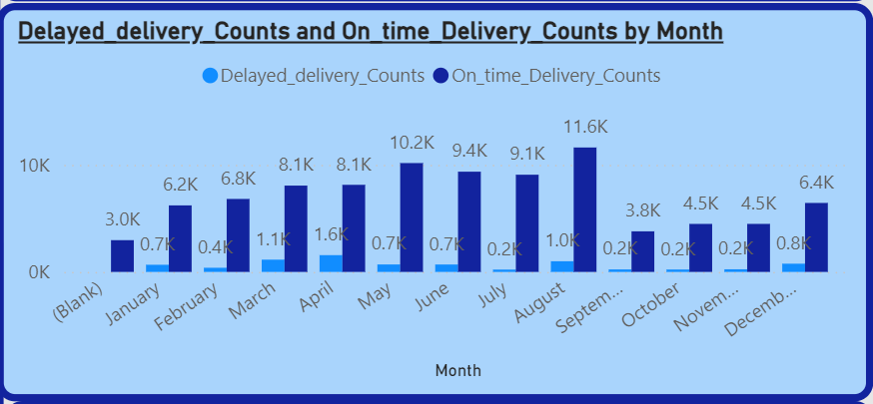
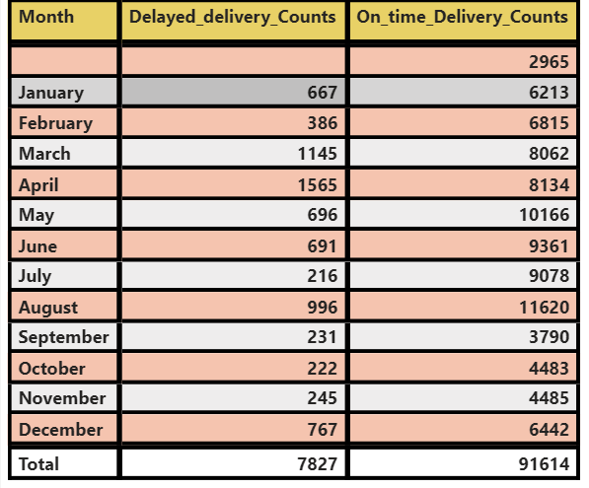
Monthly Comparison of Delayed and On-Time Orders: Create a dynamic visual that compares the number of delayed orders to the number of orders received earlier for each month. Utilize the drill through cross-report feature to provide a detailed analysis of late and on-time deliveries.
At 1565, April had the highest Delayed delivery counts and was 624.54% higher than July, which had the lowest Delayed delivery Counts at 216.﻿
Delayed delivery Counts and total On time Delivery Counts are positively correlated with each other.﻿
April accounted for 19.99% of Delayed delivery Counts.
On time Delivery Counts and Delayed delivery Counts diverged the most when the Month was August, when On time Deliver Counts were 10624 higher than Delayed delivery Counts.

Slide 6
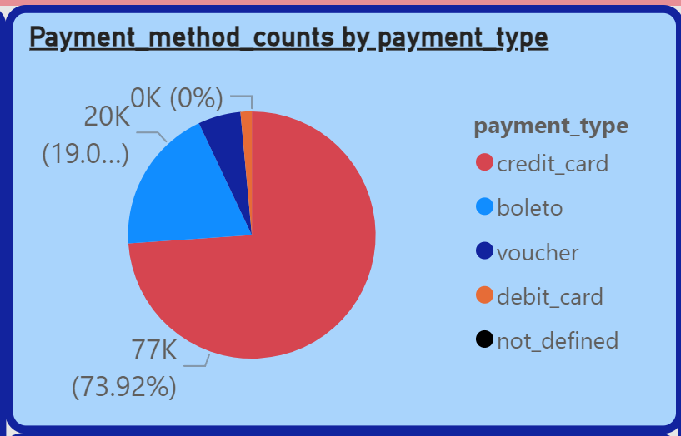
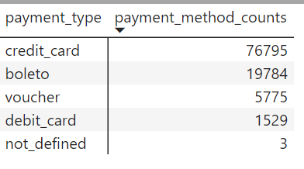
Payment Method Analysis: Analyze the most frequently used payment methods by customers using a visually appealing representation, such as a pie chart or other suitable visuals.
﻿Credit Card accounted for 73.92% of payment method counts accounting for 76,795 which is the highest among all the payment method followed by boleto and vouchers.

Slide 7
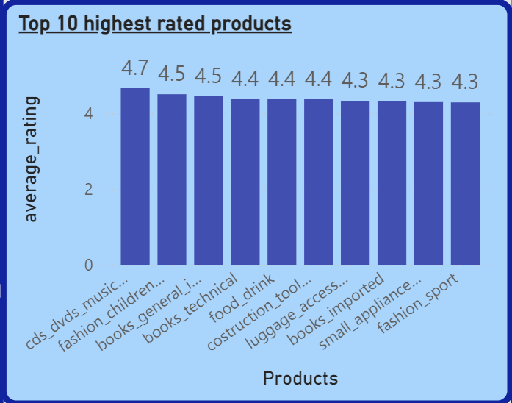
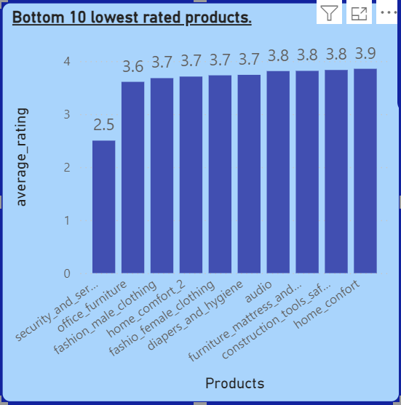
Product Rating Analysis: Determine the top 10 highest-rated products and the bottom 10 lowest-rated products using a bar or column chart.
Analysis of top 10 products :
At 4.67, CDs-DVDs musicals had the highest average rating and was 8.89% higher than fashion sport, which had the lowest average rating at 4.29.
Across all 10 Products, average rating ranged from 4.29 to 4.67.
Analysis of bottom 10 projects :
At 3.86, home confort had the highest average rating and was 54.20% higher than security and services, which had the lowest average rating at 2.50.
Across all 10 product categories, average rating ranged from 2.50 to 3.86.

Slide 8
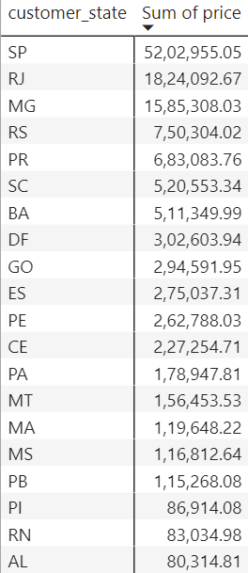
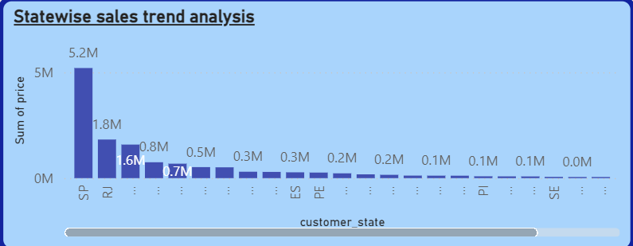
State-wise Sales Analysis: Identify and visually represent states with high and low sales, providing a clear understanding of regional sales performance.
At 52,02,955.05, SP had the highest Sum of price and was 66,353. 82% higher than RR, which had the lowest Sum of price at 7,829.43.
SP accounted for 38.28% of Sum of price.
Across all 27 customer state, Sum of price ranged from 7,829.43 to 52,02,955.05.

Slide 9
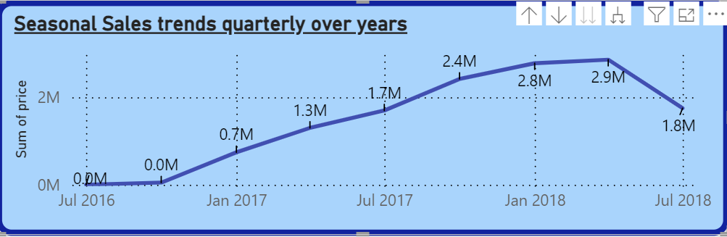
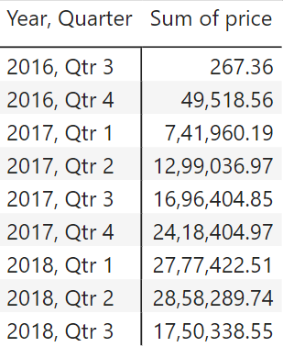
Seasonal Sales Patterns: Investigate and visualize any seasonal patterns(Quarterly) or trends in sales data over the course of the year.
2016 :
The data starts with very low sales in Q3.
A significant increase in Q4 with sales rising to 49,518.56 .
2017 :
There is a substantial jump in Q1 with sales of 741,960.19.
Continuous growth is observed each quarter, peaking in Q4 at 2,418,404.97.
2018:
The upward trend continues into Q1 and Q2 with sales reaching 2,777,422.51 and 2,858,289.74 respectively.
A decline is seen in Q3 with sales dropping to 1,750,338.55.

Slide 10
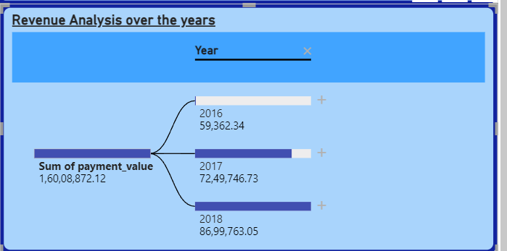
Revenue Analysis: Determine the total revenue generated by ShopNest Store and analyze how it changes over time(Yearly). Represent this information through suitable visuals to highlight trends and patterns
2016 :
In 2016 total revenue generated was 59,362.34.This year shows the minimal sales compared to the following years, suggesting that the business was likely in its initial stage or there are fewer transactions.
2017 :
In 2017 total revenue generated was 72,49,746.73, which is a significant increase from 2016 indicating a substantial growth. Sales have increased by approximately 7,190,384.39.
2018 :
In 2018 total revenue generated was 8,699,763.05 which is a continued growth from 2017. With an increase of about 1,450,016.32. This suggests sustained positive performance and possibly expansion of operations or product lines.

Slide 11
THANK YOU !!!!!!

